Slide 1
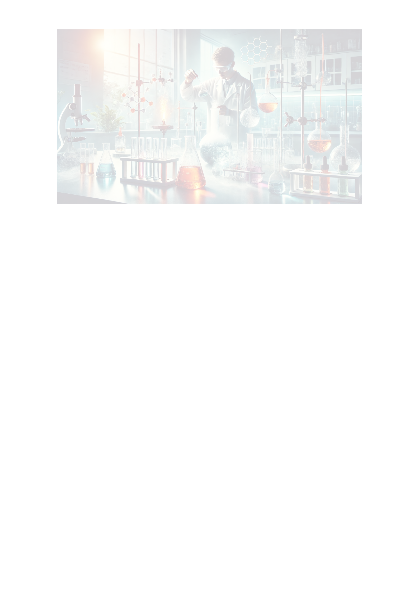
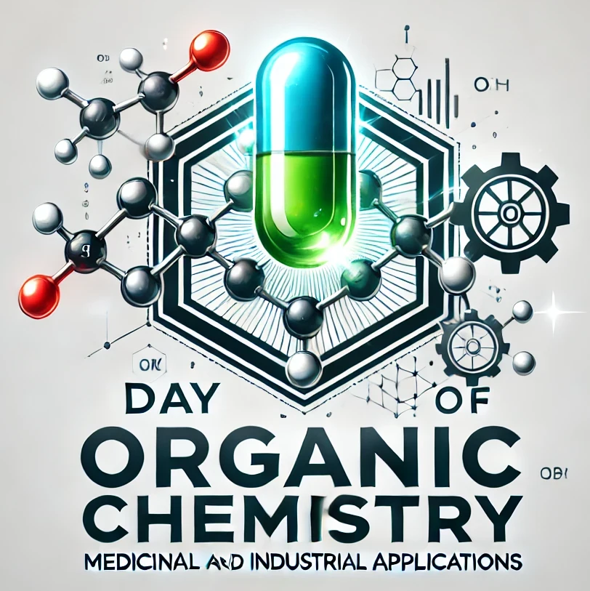
Setif-1 University FARHAT Abbas
Faculty of sciences
Department of chemistry
1st Day of Organic Chemistry and its Medicinal and Industrial Applications
DOCMIA’25 29 April 2025
Title (Times New Roman - font size 54 - bold)
Auteurs (Times New Roman - font size 44)
Organization (Times New Roman - font size 32)
Manuscript ID-XX
Abstract
Results and discussions
Results Presentation
Text: Times New Roman - font size 24
Introduction
Text: Times New Roman - font size 24
Text: Times New Roman - font size 24
Experimental Methods
System Presentation
Texte : Times New Roman – police 24
Discussions of Results
Experimental Procedure
Text: Times New Roman - font size 24
Text: Times New Roman - font size 24
Conclusion
Text: Times New Roman - font size 24

